Slide 1
Quarterly Service Performance Review
1st Quarter, FY24 (July- September 2023)
Engineering & Operations Committee
November 16, 2023

Slide 2

KPI Grouping
Service Performance
Service Delivery
Railway Asset Availability
Customer Experience
Safety and Security
Capacity
Wayside
Customer Service
Safety
Weekday - Average Ridership
Dispatches Operated
Passenger Loading
Wayside - Train Control Systems
  Wayside Train Control System
Control System
Wayside - Railway Systems
Track
Traction Power
Customer Service
Overall Customer Satisfaction
Station Agent Customer Service
Complaints
Safety – Passenger
Station Incidents
Vehicle Incidents
Safety – Employee
Lost Time Injuries
OSHA Recordable Injuries
Safety – Violations
Unscheduled Door Openings
OSHA Recordable Injuries
Punctuality
Environment
On-time – Customer
Daily / Peak
On-time – Train
Daily / Peak
Timed Train Meets - K-Line
Revenue Fleet
Environment – Stations
Outside
Inside
Environment – Trains
Cleanliness
Temperature
Environment – Code of Conduct
Gender Based Harassment
Fare Evasion
Revenue Fleet - Fleet Reliability
4 AM - Car Availability
Vehicle MTBSD - (Hours)
Security
Police Coverage
BPD Presence
BPD Response Time
Crime – Against Person
Crime – Burglary
Bike Thefts
Auto Burglaries
Auto Thefts
Progressive Policing
Operations
Transportation Staffing
Stations
Availability – Elevators
Availability – Escalators
Availability – Fare Collection
Category
Class
Slide
SAN FRANCISCO BAY AREA RAPID TRANSIT
Page | 1

Slide 3
Summary – Service Delivery
 | Metric | FY24 Q1 | Goal | Change from FY23 Q4
 | Weekday - Average Ridership | 164606 | 166062 | 3.32% | ▲
 | Trains On-Time - Daily | 83.8% | 91.0% | 5.38% | ▲
 | Customers On-Time - Daily | 92.1% | 94.0% | 1.12% | ▲
 | Trains On-Time - Peak | 83.5% |  | 8.09% | ▲
 | Customers On-Time - Peak | 92.0% |  | 1.08% | ▲
All-Day
Peak
▼ Gray arrows represent change from the previous quarter for metrics which do not have an established goal

Slide 4
Service Delivery – Delay Incident Detail
Service Delivery – Delay Incident Detail
8903 Delayed Trains Caused by Incidents
Trains Delayed - Top Ten Single Incidents
External 72%
Internal 28%
Top ten incidents = 17.6% of delayed trains
Trains Delayed by Month
FY23 Q2
FY23 Q3
FY23 Q4
FY24 Q1

Slide 5
Capacity – Ridership
Total Ridership up 10.7% over last year.
Average weekday ridership up 12.2% over last year.
Saturday ridership up 5.5% over last year.
Sunday ridership up 10.1% over last year.
Weekday Hourly System Activity
Average Ridership - Weekday
Comparison of September Ridership by Day of Week

Slide 6
Capacity – Dispatches Operated
% of Scheduled Dispatches Missed by Cause
Missed Dispatches are scheduled trains that did not run OR partial runs that were not able to dispatch from origin
Missed dispatches due to staffing shortage continue to decrease
Cancellations improved to just over 1%.
Cause categories reduced to less than 1%.
Scheduled Runs Dispatched from Origin
Hourly Scheduled Runs Dispatched from Origin
Missed dispatches
Runs dispatched

Slide 7

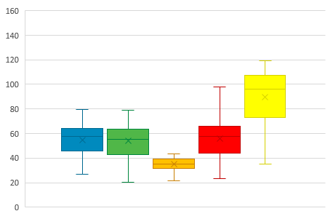
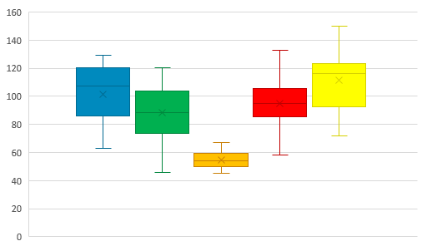
Capacity – Passenger Loading
Average Hourly Weekday Passenger Load per Car by Line
Time of Day
Passenger Load per Car for Top 5 Crowded Weekday Trains
Passenger Load per Car for Top 5 Crowded Weekday Trains
Prior Schedule - July 1st to Sep 10th
New Schedule - Sep 11th to Sep 30th
Passenger Load per Car
Legend
Passenger Load per Car
Maximum of Top 5*
123
120
108
XX¹
75th Percentile
104
105
Median
64
63
66
25th Percentile
59
BART Line Color
Minimum of Top 5*
BART Line Color
39
*Maximum & Minimum Values of Top 5 Crowded Trains with outliers removed
¹Typical Busiest Trains by Route

Slide 8
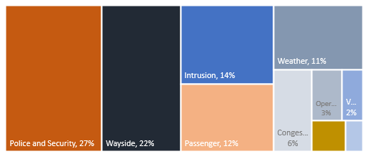
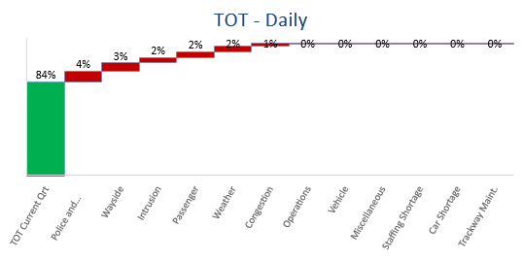
Punctuality – Trains On-Time
Estimate of Late Trains by Incident Cause (EOL)
Trains On-Time - Daily
Trains On-Time - Peak

Slide 9
Punctuality – Customer On-Time
Customer On-Time was 92.1% for the quarter.
September was the highest performing month in last five quarters.
Customer On-Time - Daily
Customer On-Time - Peak

Slide 10
Punctuality – Timed Train Meets
A meet is considered successful when there is at least 20 seconds of overlap time for both trains at the timed transfer point
Timed Train Meets on the K-Line between the Yellow and Orange lines occur as follows
  Northbound trains meet at 19th Street
  Southbound trains meet at MacArthur
Northbound Meets at 19th Street
Southbound Meets at MacArthur

Slide 11
Summary – Railway Asset Availability
 | Metric | FY24 Q1 | Goal | Change from FY23 Q4
 | Track | 0.87 | 0.30 | (694.17%) | ▼
 | Traction Power | 1.13 | 1.00 | (81.28%) | ▼
 | Wayside Train Control System | 1.21 | 1.30 | (27.01%) | ▼
 | Computer Control System | 0.32 | 0.30 | (8.98%) | ▼
 | Transportation | 0.57 | 0.50 | 43.79% | ▲
 | Vehicle MTBSD - (Hours) | 12755 | 9600 | 44.22% | ▲
 | 4 AM - Car Availability | 637 | 581 | (8.47%) | ▼
 | DMU - MDBF (Miles) | 39420 | 28000 | (57.79%) | ▼
 | Elevators in Service - Station | 98.7% | 98.0% | 0.05% | ▲
 | Elevators in Service - Garage | 99.7% | 97.0% | (0.14%) | ▼
 | Escalators in Service - Street | 97.5% | 93.0% | 1.91% | ▲
 | Escalators in Service - Platform | 98.7% | 96.0% | 1.52% | ▲
 | Automatic Fare Collection - Gates | 99.3% | 98.0% | (0.10%) | ▼
 | Automatic Fare Collection - Vendors | 99.0% | 95.0% | (0.18%) | ▼
Wayside Equipment
Revenue Vehicle
Station Equipment

Slide 12
Railway Asset Availability – Detail
1214 Train delays for the quarter
Rail Inspection Vehicle identified defects that required slow orders.
Rail Detector found rail defects that required slow orders.
Train Control experienced two switch failures and a false occupancy.
Communication ICS to FIP failure on July 8th.
Traction Power lost 3rd rail power on July 10th.

Slide 13



Wayside Equipment – Delayed Trains by System
Track System
Wayside Train Control System
Traction Power System
Wayside Computer Control System

Slide 14


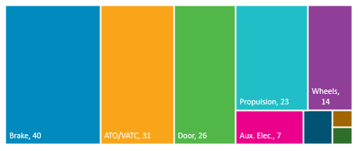
Revenue Fleet – Reliability
Breakdown of Delayed Trains by Vehicle System
Car Availability at 4 AM
Mean Time Between Service Delays
596
197
Car count as of 09/30/2023

Slide 15
Operations - Transportation
Operations
Train delays due to staff shortages were nearly eliminated this quarter.
Continued hiring of Train Operators is driving delays down.
78 train delays due to staffing shortage for the quarter.

Slide 16
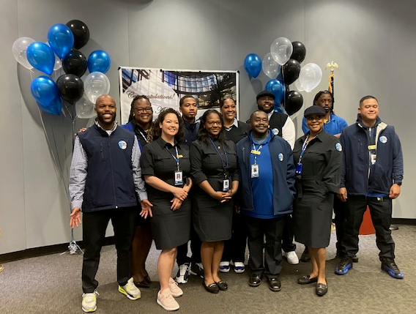
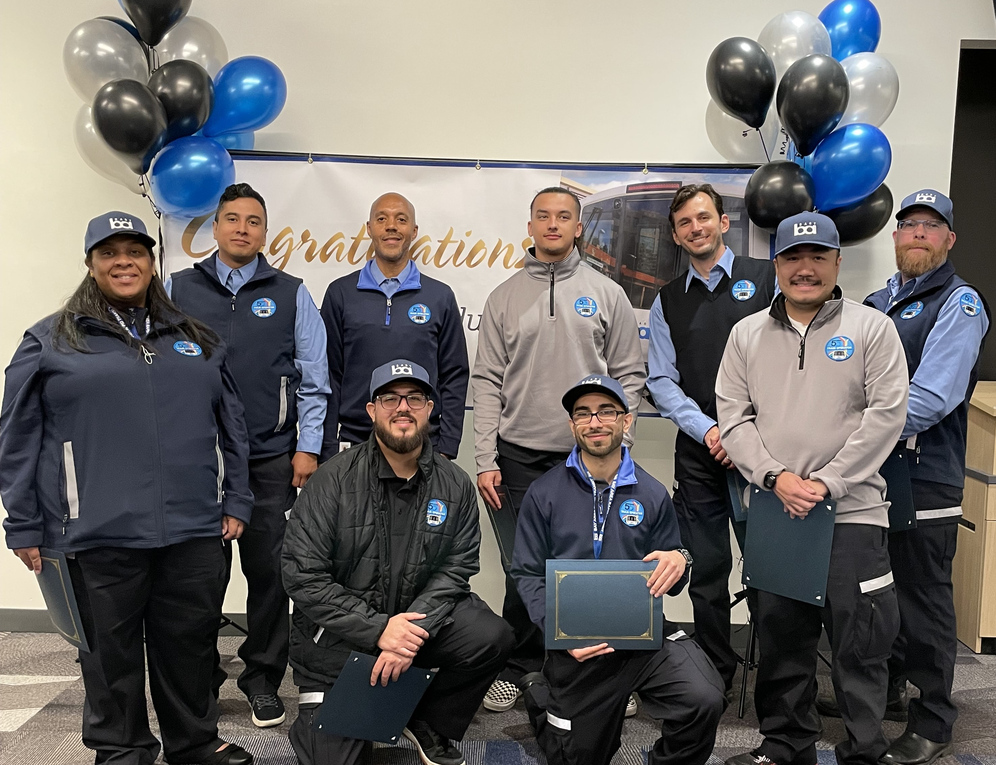
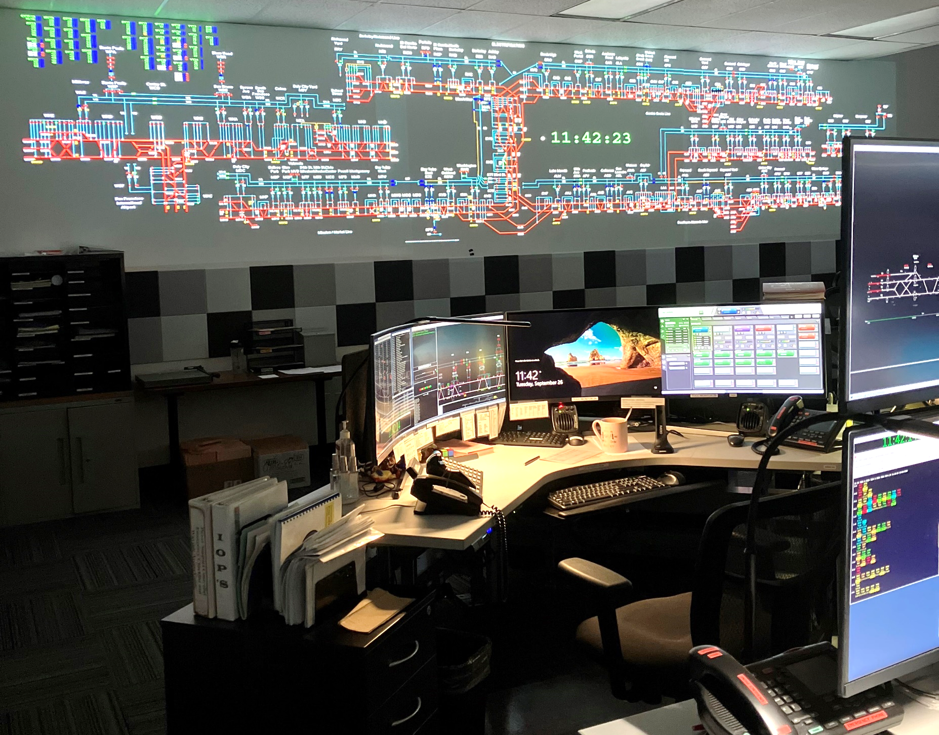
Hiring Metrics - Priority Positions
Station Agent
Target Range: 420 to 430
+
Train Operator
Target Range: 530 to 540
+
Rail Operations Controller
Target Range: 30 to 35
+

Slide 17
Station Equipment – Elevator Availability
Station Elevator
Goal met
Garage Elevator
Goal met
Station Elevator
Garage Elevator
Availability
*E-line Elevator and Escalator are included

Slide 18
Station Equipment – Escalator Availability
Street Escalator
Goal met
Platform Escalator
Goal met
Street Escalator
Platform Escalator
Availability

Slide 19

Station Equipment – Automated Fare Collection
Gate Availability
Goal met
Vendor Availability
Goal met
Gate Availability
Vendor Availability
Availability
Availability

Slide 20
Summary – Customer Experience
 | Metric | FY24 Q1 | Goal | Change from FY23 Q4
 | Overall Customer Satisfaction | 75% |  | -
 | Station Agent Customer Service | 4.5 |  | 15%
 | Complaints per 100,000 Passenger Trips | 28.69 | 5.1 | (34.06%) | ▲
 | Train Temperature | 4.14 |  | 0.97%
 | Train Interior Cleanliness | 3.63 |  | (2.94%)
 | Environment Outside Stations | 3.50 |  | 0.98%
 | Environment Inside Stations | 3.50 |  | (0.38%)
 | Gender Based Harassment | 8% |  | (11.11%)
 | Fare Evasion | 24% |  | (4.31%)
As a reminder, goals for Customer Experience are not being reported because BART has redesigned the PES surveys and rating criteria. Goals will be re-established after one year of new data is available.
Customer Experience
Train Environment
Station Environment
Code of Conduct
▲ Gray arrows represent change from the previous quarter for metrics which do not have an established goal

Slide 21
Customer Service – Experience
Overall Customer Satisfaction 74%
Up 1% from last quarter
Station Agent Customer Service is 4.5
Up 0.6 on the 5-point scale
Overall, how satisfied are you with the services provided by BART?
Customer service from Station Agent (if used today)
Overall Customer Satisfaction
Station Agent Customer Service
(Excellent)
Mean
(Poor)

Slide 22
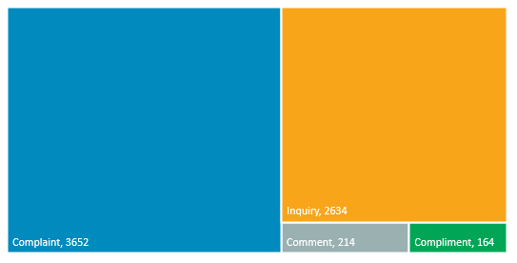
Customer Service – Cases by Type
Breakdown of 6664 Inquiry Cases
Inquiry Cases – FY24 Q1
Compliment Cases – FY24 Q1

Slide 23
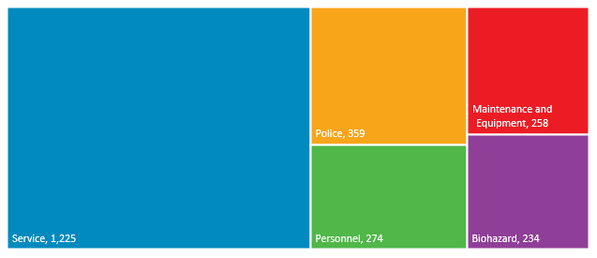
Customer Service – Complaint Cases
Breakdown of Top Five Complaint Categories of 3652 Complaints
Customer Complaints
FY24 Q1 Trending Customer Complaints

Slide 24
Environment – Stations
Environment Outside Station
This is a composite score which incorporates the appearance of BART landscaping, walkways, and entry plaza (67%), and the cleanliness of the parking lot (33%).
Environment Inside Station
This is a composite score which incorporates the appearance of the platform (40%), concourse (25%), escalator (10%), stairwells (7.5%), elevator (10%), and restroom (7.5%).
Environment Outside Station
Environment Inside Station
(Excellent)
(Excellent)
(Excellent)
Mean
Mean
(Poor)
(Poor)
(Poor)
Data acquired from PES Survey

Slide 25
Environment – Trains
Customer Rating – Interior Cleanliness
Customer Rating - Temperature
This is a composite score which incorporates the appearance of the train interior (60%), and the appearance of any graffiti on the train (40%).
Customer Rating – Interior Cleanliness
Customer Rating - Temperature
(Excellent)
(Excellent)
Mean
Mean
(Poor)
(Poor)
Data acquired from PES Survey

Slide 26
Environment – Code of Conduct
Gender Based Harassment
Fare Evasion
Have you experienced gender-based sexual harassment at BART in the last six months?
Did you see anyone enter or exit the Station without paying their fare today?
Gender Based Harassment
Fare Evasion
Data acquired from PES Survey

Slide 27
Summary – Safety and Security
 | Metric | FY24 Q1 | Goal | Change from FY23 Q4
 | Vehicle Incidents/Million Patrons | 0.24 | 0.6 | 42.85% | ▲
 | Unscheduled Door Openings/Million Car Miles | 0.24 | 0.2 | 46.66% | ▲
 | Rule Violations Summary/Million Car Miles | 0.14 | 0.25 | 48.14% | ▲
 | Station Incidents/Million Patrons | 0.94 | 2 | 33.33% | ▲
 | OSHA-Recordable Injuries/Illnesses/Per OSHA | 14.69 | 12 | (14.67%) | ▼
 | Lost Time Injuries/Illnesses/Per OSHA | 8.44 | 6.5 | (8.06%) | ▼
 | Police Response Time per Emergency Incident | 4.39 | 5 | (10.85%) | ▼
 | Bike Thefts | 50 | 50 | (66.66%) | ▼
 | Auto Thefts/1,000 Parking Spaces | 4.24 | 2 | (3.63%) | ▼
 | Auto Burglaries/1,000 Parking Spaces | 4.60 | 3.5 | (6.48%) | ▼
 | BART Police Presence | 17.3% | 12% | 89.92% | ▲
 | Crimes Against Persons/Million Riders | 7.86 | 2 | 14.15% | ▲
Safety
Security

Slide 28
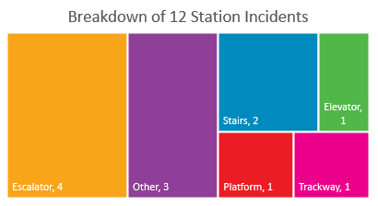
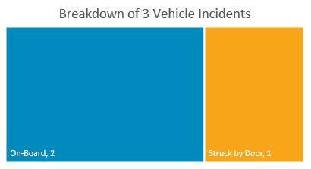
Safety – Passenger
Station Incidents
Vehicle Incidents
Station Incidents
Vehicle Incidents

Slide 29
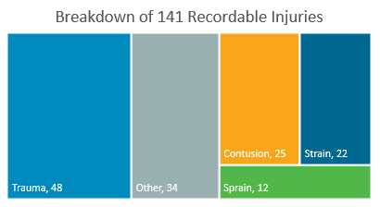
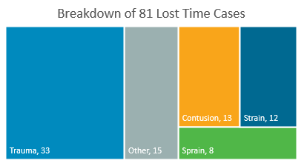
Safety – Employee
Lost Time due to Injuries
OSHA Recordable Injuries
Lost Time due to Injuries
OSHA Recordable Injuries

Slide 30
Safety – Procedure Violations
Unscheduled Door Openings
5 Unscheduled Door Openings in FY24 Q1
  All 5 due to Passenger Action
  5 less than previous quarter
Rule Violations
3 Rule Violations in FY24 Q1
Zero rule violations in July
Unscheduled Door Openings
Rule Violations

Slide 31

Security – Police Coverage
Police Presence
Continued uniformed visibility, daytime and nighttime staffing at Civic Center
Police Response Time
Goal met
Did you see BART Police in the station today?
Did you see BART Police outside the station today?
Did you see BART Police on this train?
BART Police Response Time
BART Police Presence
Data acquired from PES Survey

Slide 32



Crime – Theft and Burglary
Bike Theft
Auto Theft
Auto Burglary
Goal met
Goal not met
Goal not met
Bike Theft
Auto Theft
Auto Burglary

Slide 33
Crime – Against Persons
Electronic Robbery
Count of Incidents
Crime Against Persons

Slide 34
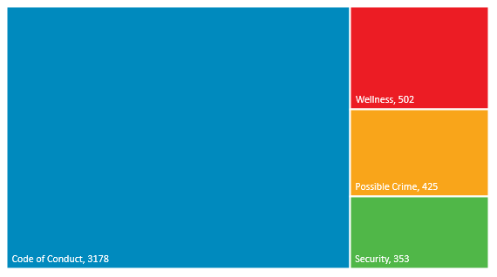
BART Watch App
Breakdown of 4458 BART Watch Reports
Total BART Watch & Text Counts by Month
FY23 Q3
FY23 Q4
FY24 Q1

Slide 35
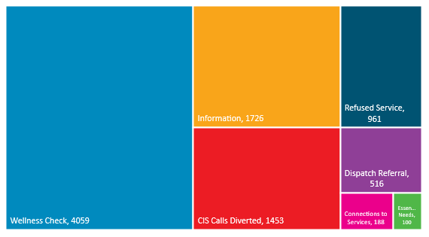
Progressive Policing Contacts and Outcomes
50 Narcan incidents total; 5 of which were administered by CIS
Summary of Contacts (9,003)
Connections to Services by Partner (188)

Slide 36
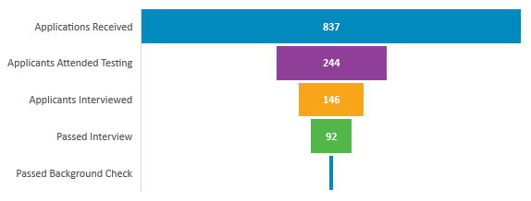
Police Hiring Metrics
Police Hiring Pipeline – FY24 Q1
Recruitment campaign launch from Aug – Oct highlighting 22% salary increase.
Hosted two recruitment open houses
  Next one scheduled on November 18th
“Join BART PD” website launched in July
  80K views to date
Increase in number of applicants interviewed
  FY23 Q4: 57
  FY24 Q1: 146
9
Police Headcount Tracking
Current PCN’s: 185
*As of 09/30/23

Slide 37
Questions?

